Slide 1

Predicting Severity of Accidents in Seattle
Shwetha Acharya

Slide 2
Introduction
Problem Statement:
In the recent past we have seen an increase in the number of road accidents in Seattle
With this trend, driving on highways and roads poses a risk to the lives of people and property damage.
This project aims at predicting accident severity based on historic data.
Target Candidates:
Drivers and passengers of various vehicles as a measure to fore warn them
Traffic department and cops monitoring roads and highways

Slide 3
Data Acquisition & Cleaning
Data Source: Seattle Department of Transportation - Traffic Management Division, Traffic Records Group publishes information on all types of collisions from 2004 till date (2020).
In total 19000+ records and 37 attributes
Features include:
Accident severity in terms of numeric codes,
Collision description,
Junction/Address type (whether intersection, alley or block),
X and Y co-ordinates,
Number of vehicles and pedestrians involved
Light, road and weather conditions,
Speeding, whether driving under the influence
Cleaned data has 55 features (since many variables are categorical)

Slide 4
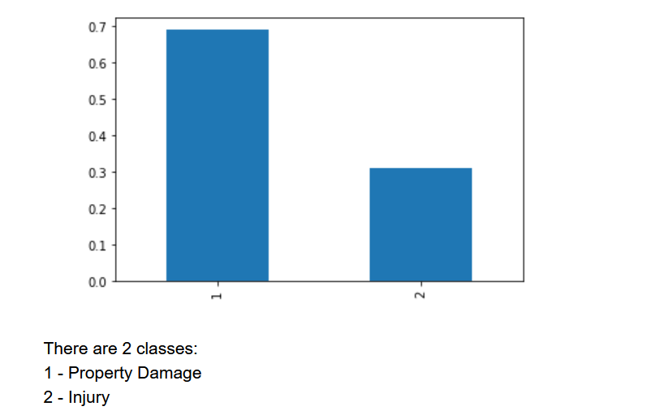
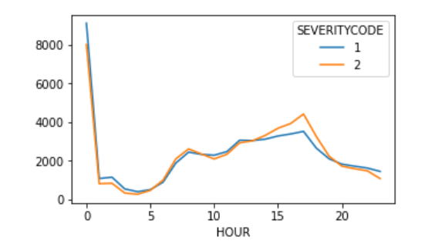
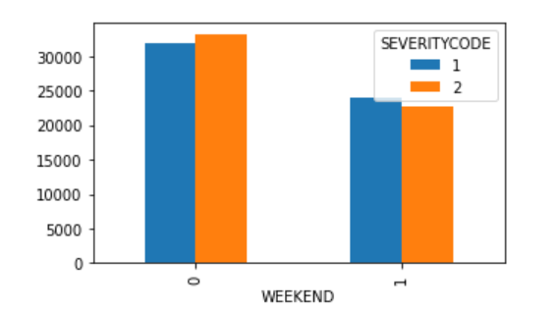
Data Analysis
Distribution of classes for severity code is imbalanced.
Under-Sampling was done to fix this .
At midnight and in the afternoon/early evening,
number of accident cases is on the higher side.
At early evening, injury causing accidents are more.
On weekends there are comparatively a smaller number of accidents.
Out of total number of accidents, there is an equal proportion of
property damage and injury-based accidents be it weekends or weekdays.

Slide 5
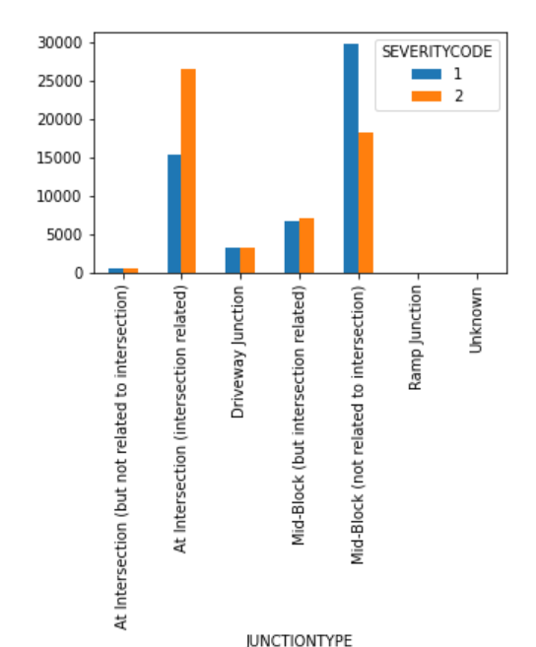
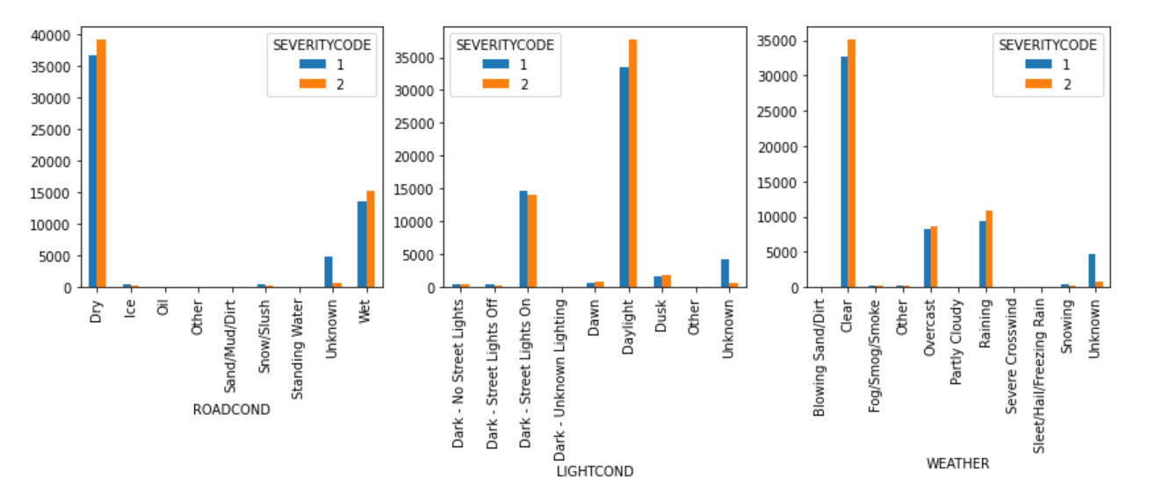
Data Analysis
Property damage is maximum with accidents at “Midblock” junction, while “at intersection” injury resulting accidents are maximum
Majority of accidents seem to happen when roads are dry in daylight and clear weather

Slide 6
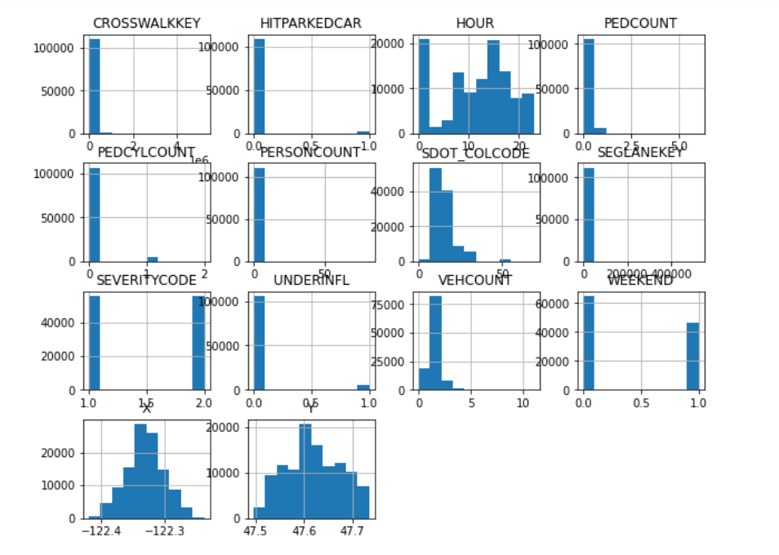
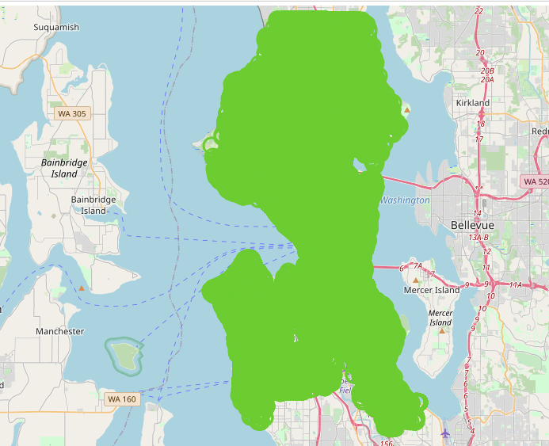
Data Analysis
Frequency Distribution of variables - variables are either constant(with little variance) or skewed
Accident locations are spread across Seattle. Almost all areas are covered (Plotting X and Y co-ordinates on a map)

Slide 7
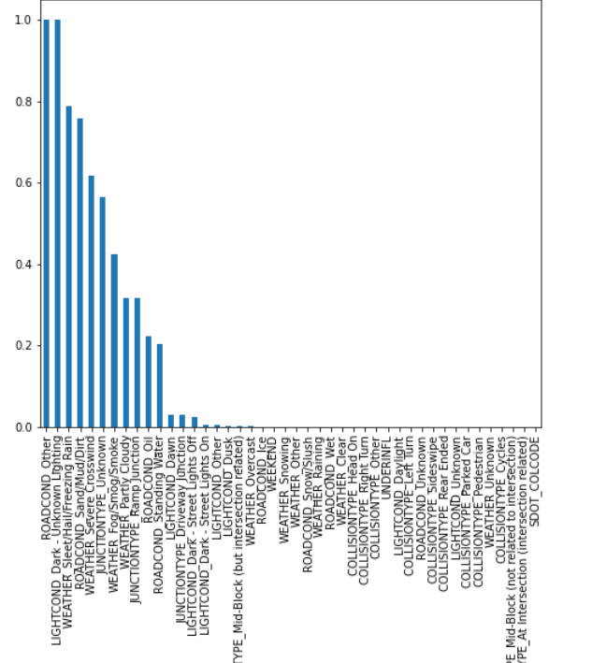
Feature Selection
Performed Chi Square Test to pick relevant features
and as most of the input variables were categorical.
Now we have only 40 features

Slide 8
Predictive Modeling
Classification algorithms to predict severity codes. Following algorithms were used:
Decision Trees
RandomForest Classifier
SVM
Logistic Regression
5. XGBoost RF Classifier
Accuracy_score, f1 score , confusion matrix and cross validation scores were used to evaluate models and models exhibited an accuracy of around 70+% with Decision trees, XGBOOST, RandomForest Trees and logistic regression with slight variation.
However, SVM takes 80-90% more time than other models to execute.
Classification Model | Accuracy | F1-Score | Cross Val Score | Log Loss
DecisionTrees | 0.706 | 0.699 | 0.6998 | NA
RandomForest | 0.71 | 0.678 | 0.7 | NA
SVM | 0.7 | 0.698 |  | NA
Logistic Regression | 0.702 | 0.698 | 0.7 | 0.54
XGBoost Random Forest Classifier | 0.7146 | 0.706 | 0.7 | NA

Slide 9
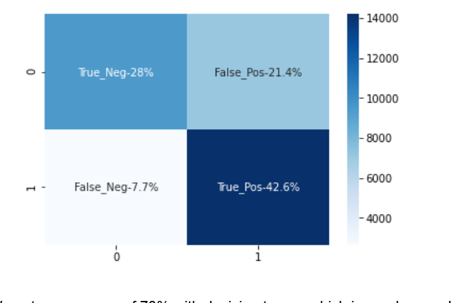
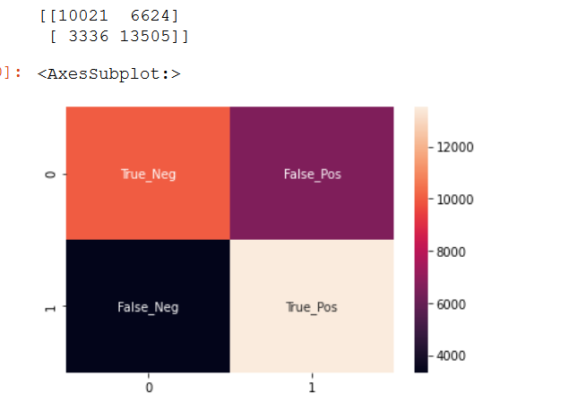
Model Evaluation
Confusion Matrix for Decision Trees and Logistic Regression
Percentage of False Positive is more than 20%

Slide 10
Conclusion
Analysis of the relationship between accident severity and general environment conditions and the road lanes was done
We identified that some of the weather, road, light conditions, are among the most important features that affect the severity.
Classification models were built to predict the severity of accidents and this information can be very useful to people taking the corresponding routes and to the traffic department.
Model accuracy can be further improved by getting more data on other features such as attention indicators and speeding, driver’s profile, vehicle working status or any related events which may lead to distraction/deviation

